Slide 1
PREPARING GEN-Z ENTERING THE WORKPLACE

Slide 2
AGENDA
Introductions to Braven and America Needs You
The current job market
The Rise of the Gen-Z Professional
Sharing collective best practices
Q & A

Slide 3
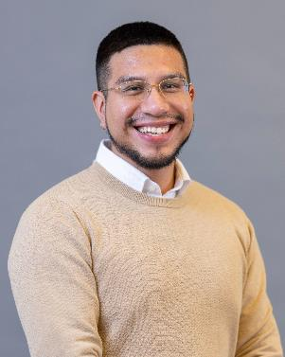
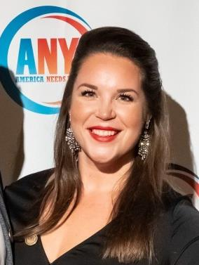
Presenters
Jose Torres
Program Manager of Recruitment & Workforce Strategy
Braven
Emily Ashton
Chief External Affairs Officer
America Needs You

Slide 4
MISSION
Braven empowers promising underrepresented young people on their path to college graduation and strong first jobs, which lead to meaningful careers and lives of impact.
KEY OUTCOME
Increased rates of securing high quality job/grad school admission within 6 months of graduation
4
Notes:
1 MIN
Good morning everyone and thank you for joining this session with us! My name is Jose Torres, and I work as a Program Manager for Braven, which is a national nonprofit dedicated to helping students from underrepresented background achieve college to career success.
Our mission is to…
Our key outcome is strong first jobs which we define as worthy of their degree. Namely:
Required a BA
Opportunity for Health and Wealth
Pathway to advancement
Today I will be highlighting

Slide 5
THE 4 ACCESS GAPS
Current systems aren’t set up to help students build critical skills, confidence, experience and networks:
SKILLS
CONFIDENCE
EXPERIENCE
NETWORKS
CONFIDENCE
ONLY 1 IN 10 BUSINESS LEADERS
in the US strongly feels that a college degree equips graduates with the skills and competencies their business needs.¹
First generation, underrepresented students battle STEREOTYPE THREAT and IMPOSTER SYNDROME in school and the workplace. ²
First generation students
at large public universities are
13% LESS LIKELY
TO HAVE UNDERGRADUATE INTERNSHIPS. ³
YOU ARE 3X MORE LIKELY TO HAVE A STRONGER NETWORK
if you grew up in a zip code with a median income over $100K. ⁴
UNDERLYING THESE FOUR GAPS, IS A LACK OF RESOURCES
3,179 COLLEGE STUDENTS : 1 COLLEGE CAREER ADVISOR
1 Gallup Poll, 2 Whistling Vivaldi, 3 NACE First Destination Survey , 4 LinkedIn
© 2023 Braven, Inc. All Rights Reserved
Notes:
The 15 week Braven curriculum provides students the skills, confidence, experience, and network they will need to achieve success. A lot of it is helping students with the storytelling.
3,179 students per each college career advisor

Slide 6
THE BRAVEN MODEL
Braven empowers promising, underrepresented young people on their paths to launching successfully in the modern economy.
EMBEDDED IN HIGHER EDUCATION
1 SEMESTER COURSE: ACCELERATOR
UNTIL GRADUATION
+
Online Content
Coaches & Cohorts
1:1 Mentoring
Opportunities Newsletter
Career-Building Experiences
VOLUNTEERS & EVENTS
L&D FOR EMPLOYEES
INTERNSHIPS & JOBS
JOB-READY, DIVERSE TALENT
© 2023 Braven, Inc. All Rights Reserved
Notes:
The Braven Accelerator Course is a vibrant learning experience that gives you the roadmap and tools to channel your ambition and hard work. You’ll work with a Leadership Coach, and a cohort of peers as you partake in activities that build your leadership and career readiness.
Learn how to leverage your life story as a career asset.
Fine-tune your resume and cover letter, and practice interviewing.
Hone competencies sought by today’s top employers, including: working in teams, leadership, problem-solving, networking and communicating, and operating and managing.
Grow your network on campus and professionally.

Slide 7
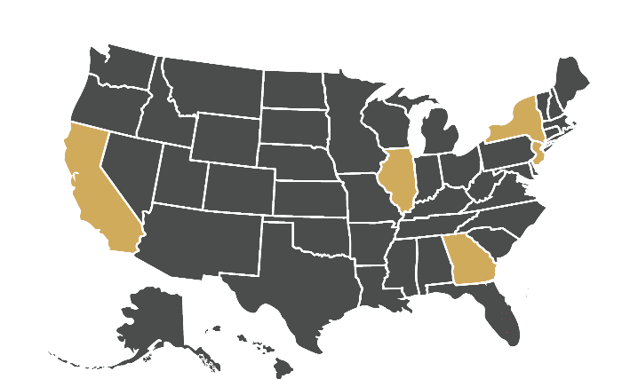
7,470+ FELLOWS & GROWING QUICKLY
894
FELLOWS SERVED Launched Spring 2020
567
FELLOWS SERVED Launched Spring 2018
315
FELLOWS SERVED Launched Fall 2022
257
FELLOWS SERVED Launched Spring 2023
1,951
FELLOWS SERVED Launched Spring 2014
1,382
FELLOWS SERVED Launched Fall 2015
1,143
FELLOWS SERVED Launched Spring 2022
968
FELLOWS SERVED Launched Fall 2019
7
Notes:
7,000 Fellows will have completed the Braven Accelerator across seven institutions of higher education and through our BravenX model. NIU and National Louis University specifically in Illinois
Of these, more than 2,300 graduates who’ve participated in Braven’s core model have reached graduation and the workforce.
Over the next three years, we will support an additional 8,000+ Fellows, generating an estimated $2B cumulative uplift in lifetime earnings for all Fellows served to date and in these next few years.

Slide 8
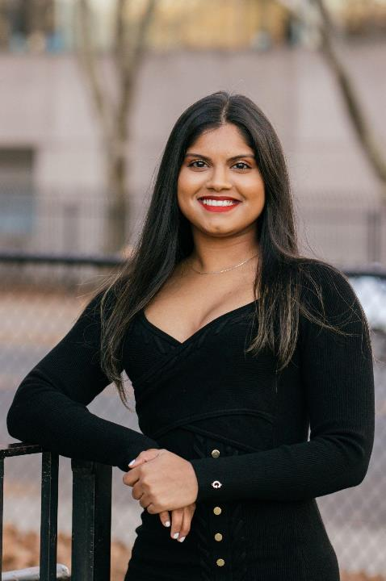
THE AMERICAN PROMISE IN ACTION
In 2022, 603 Braven Fellows graduated from college.¹ This new class is outpacing their peers nationally in strong job attainment by 14 percentage points (61% vs 47%) within six months of graduation.²
SIX MONTHS AFTER GRADUATION
Braven Fellows
61%
A difference of 14 percentage points
Graduates of color from public universities
47%
National average of all graduates
56%
FELLOW DEMOGRAPHICS
24%
Black
88%
24%
AAPI
People of Color
35%
Latinx/a/o
75%
of Braven graduates make more in their first job out of college than either of their parents parents did at the same age.
¹We have jobs data for 81% of FY22 graduates from our core model higher education partners: Lehman College, San José SJSU, and RU-N.
² National benchmark estimates are based on NACE’s 2021 First Destination Survey (publicly available and custom cut data) and underemployment research from the Federal Reserve Bank of New York.
MANISHA SRIKISSOON Lehman Fellow, Spring 2022
MANISHA SRIKISSOON Lehman Fellow, Spring 2022
8
Notes:
At Braven, our fellows are proving what’s possible when equipped with the skills, confidence, experiences and networks outpacing their peers nationally in strong job attainment. We measure our success against national baselines of quality opportunity attainment

Slide 9
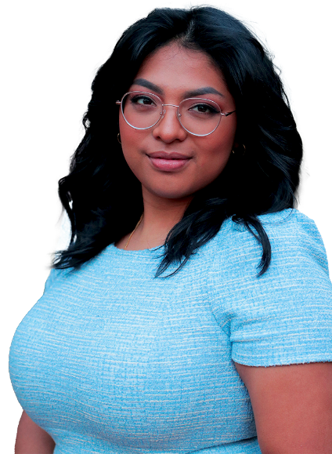
BUILDING CAREER WEALTH & HEALTH
A high quality first job helps individuals build long-term wealth and health. Braven defines a strong first job as one that requires a bachelor’s degree and is full-time, as well as includes some combination of promotion pathways, employee benefits, and a market-competitive starting salary. ¹
$56,777
MEAN SALARY OF RECENT BRAVEN GRADUATES
This is compared to a mean starting salary for 2021 graduates from public 4-year colleges of $41,500.²
69%
83%
OF RECENT BRAVEN GRADUATES
OF RECENT BRAVEN GRADUATES
are in roles aligned with their long-term career interests
have a job with employer provided benefits
CYNTHIA CRIOLLO SPRING 2021 FELLOW
¹ Questions about graduates’ salary were optional on our
annual 2022 Post-Accelerator Fellow Survey.
² NACE First Destination Survey for the College Class of 2019

Slide 10
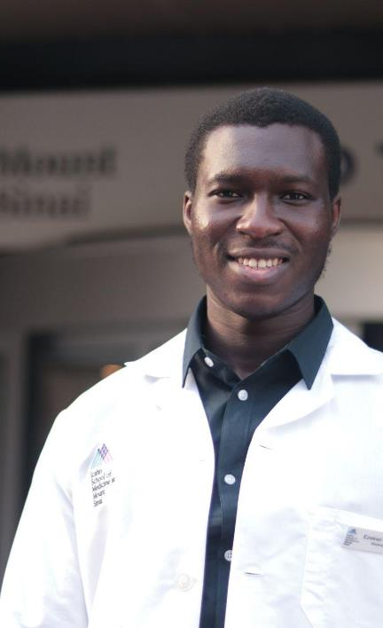
THE AMERICAN PROMISE IN ACTION pg2
When students are given access to information capital and networks as well as the opportunity to practice professional skills, the American promise is attainable within semesters. ¹
75%
ARE ALREADY OUTEARNING THEIR PARENTS IN THEIR VERY FIRST JOB OUT OF COLLEGE.
By comparison, by age 30, most Americans have a 50-50 shot of outearning their parents.²
OF BRAVEN GRADUATES
MOST POPULAR INDUSTRIES FOR BRAVEN FELLOWS WITH STRONG OPPORTUNITIES
TECHNOLOGY / HEALTHCARE / MANUFACTURING
BANKING & FINANCE / ACCOUNTING
EZEKIEL OLUMUYIDE SPRING 2021 FELLOW
¹ Questi1 Inclusive of all Braven graduates from FY18-FY21
2 Chetty, Raj et al. The Fading American Dream: Trends in Absolute Income Mobility Since 1940. Science, December 2016.
3 Translation: Work hard and work smart, my friend. Hard and smart work brings success.

Slide 11
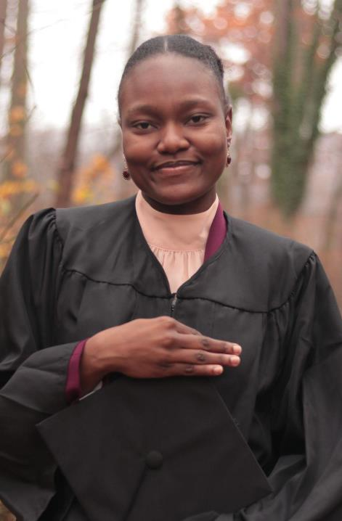
PURPOSE DRIVES PERSISTENCE
In terms of college persistence and graduation, our 945 all-time Braven Fellows at our public university partners are showing incredibly encouraging results.
Braven Fellows nationally have achieved a 91% on-time graduation rate…
91%
…Compared to about 7 in 10 of Braven Fellows’ peers who graduate on time.
Implied 6-year graduation rate for Black and Latinx students who persisted from freshman to sophomore year at four-year public institutions. Sources: U.S. Department of Education, National Center for Education Statistics, Digest of Education Statistics, 2021 release of Tables 326.10, 326.30, and 306.50.
Braven data includes graduation data of 945 Braven Fellow graduates at Rutgers-Newark, San José State University, and Lehman College, exclusive of any Fellows who took Braven as a senior.
NADGEDA MAGLOIRE Lehman Fellow
© 2023 Braven, Inc. All Rights Reserved

Slide 12
ENCOURAGING LEVELS OF INTERNSHIP ATTAINMENT
For college students, internships serve as critical proof points of experience that open professional doors. Compared with their peers nationally, our 2022 graduates were 6 percentage points more likely to have at least one internship during their college experience.
Braven 2022 Graduates
67%
A difference of 6 percentage points
Graduates from all four-year institutions
61%
NATIONAL 2022
62%
Graduates of color from all four-year institutions
LEAH WEBSTER SPRING 2020 FELLOW
¹ These insights are from Braven predictive analyses across three statistical models (logistic regressions, elastic net, and random forest) across multiple regression specifications. Data analyzed for all-time Braven Fellow graduates through the class of 2021.
CLAUDE SIAMBE Fall 2021 Fellow
© 2023 Braven, Inc. All Rights Reserved

Slide 13
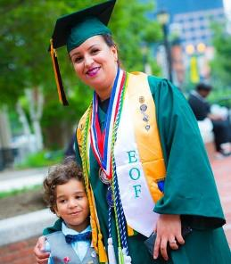
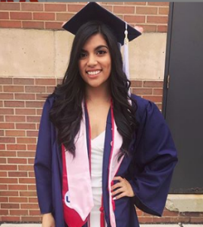
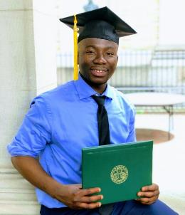
WHO WE ARE
America Needs You (ANY) helps first-generation college students build the skills, confidence, and networks to thrive in their dream careers.
Notes:
*
On average, over the past ten years…

Slide 14
10+ YEARS OF SUCCESS
3,500 students served
5,000 internships secured
20,000 volunteers engaged
500,000 hours of mentorship provided
Notes:
*
Fellows receive:
INTENSIVE CAREER DEVELOPMENT
24 Saturday workshops over the course of two years.
ANY follows a best-in-class curriculum focused on professional skills, career exploration, college completion, and personal growth.
ONE-ON-ONE MENTORSHIP
Each student (Fellow) is matched one-on-one with a mentor (Mentor Coach).
These pairs complete 220 hours of mentoring over two years.
Mentor Coaches provide industry insight and connections, as well as help Fellows set goals and stay on track academically and professionally.
ROBUST NETWORKS
Fellows interact with thousands of diverse professionals through workshops, Career Days (on-site employer visits), and internship/job opportunities at companies.
These opportunities allow Fellows to grow their professional, academic, and social networks.
HOLISTIC SUPPORT
ANY supports Fellows in over­coming personal and academic challenges, such as transfer support for Fellows enrolled in community college.

Slide 15
OUR PROGRAMS
THE FELLOWS PROGRAM
FIRSTGENU
24 in-person Saturday workshops
Monthly enrichment events
1:1 mentorship
Extensive internship and full-time job networks
Holistic support, including grants
Self-paced, virtual career development courses
Online cohort support
Networking and professional enrichment events
Career support office hours
Digital badges
"This opportunity has helped me secure an internship during my sophomore year, it has taught me financial literacy and so many more lessons on how to develop myself and my personal brand in my career path. In addition, it has resulted in friendships that will last past graduation.“ - Tyler
Notes:
*
Fellows receive:
INTENSIVE CAREER DEVELOPMENT
24 Saturday workshops over the course of two years.
ANY follows a best-in-class curriculum focused on professional skills, career exploration, college completion, and personal growth.
ONE-ON-ONE MENTORSHIP
Each student (Fellow) is matched one-on-one with a mentor (Mentor Coach).
These pairs complete 220 hours of mentoring over two years.
Mentor Coaches provide industry insight and connections, as well as help Fellows set goals and stay on track academically and professionally.
ROBUST NETWORKS
Fellows interact with thousands of diverse professionals through workshops, Career Days (on-site employer visits), and internship/job opportunities at companies.
These opportunities allow Fellows to grow their professional, academic, and social networks.
HOLISTIC SUPPORT
ANY supports Fellows in over­coming personal and academic challenges, such as transfer support for Fellows enrolled in community college.

Slide 16
FELLOW ELIGIBILITY
I am a first-generation college student
I plan to graduate with my Bachelor’s degree in 2025 or later
I am currently eligible to work full-time in the U.S.
I am low-income by my state HUD standards (most Pell recipients qualify!)
I am available to attend monthly Saturday workshops
I am fully vaccinated against COVID-19
Notes:
*
You are fully vaccinated if you have received a second dose in a two-dose vaccine series [Moderna or Pfizer] or two weeks after you have received a single-dose vaccine [Johnson and Johnson])

Slide 17
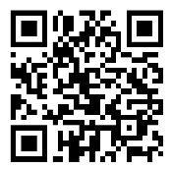
FirstGenU ELIGIBILITY
I am a first-generation college student
I am currently pursuing an
associate’s or bachelor’s degree
I have access to the internet
americaneedsyou.org/firstgenu
Notes:
*
You can sign up for FirstGenu right now and get started right away!

Slide 18
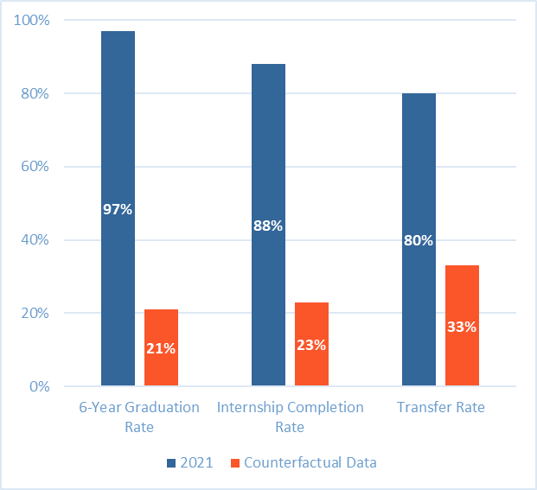
IMPACT
In 2021:
97%
of Fellows graduated within six years compared to 21% of low-income, first-generation students in the U.S.¹
88%
completed career-trajectory internships compared to 23% of first-generation students in the U.S.²
The Pell Institute, Indicators of higher education equity in the United States, 2021
NASPA, First-generation college graduates’ participation in extracurricular and co-curricular activities as undergraduate students, 2016.
Community College Research Center, What we know about transfer, 2015.
Notes:
*
Fellows receive:
INTENSIVE CAREER DEVELOPMENT
24 Saturday workshops over the course of two years.
ANY follows a best-in-class curriculum focused on professional skills, career exploration, college completion, and personal growth.
ONE-ON-ONE MENTORSHIP
Each student (Fellow) is matched one-on-one with a mentor (Mentor Coach).
These pairs complete 220 hours of mentoring over two years.
Mentor Coaches provide industry insight and connections, as well as help Fellows set goals and stay on track academically and professionally.
ROBUST NETWORKS
Fellows interact with thousands of diverse professionals through workshops, Career Days (on-site employer visits), and internship/job opportunities at companies.
These opportunities allow Fellows to grow their professional, academic, and social networks.
HOLISTIC SUPPORT
ANY supports Fellows in over­coming personal and academic challenges, such as transfer support for Fellows enrolled in community college.

Slide 19
IMPACT FOR INDUSTRIES
ANY partners with top companies to build diverse talent pipelines. With over 120 hours of intensive career development, Fellows are highly competitive internship and employment candidates.
When compared to other student interns, supervisors rated ANY Fellows above average in:
Building relationships and networking
Professional etiquette
Giving and receiving feedback
Working in teams
Managing up and taking initiative
Notes:
*
On average, over the past ten years…

Slide 20
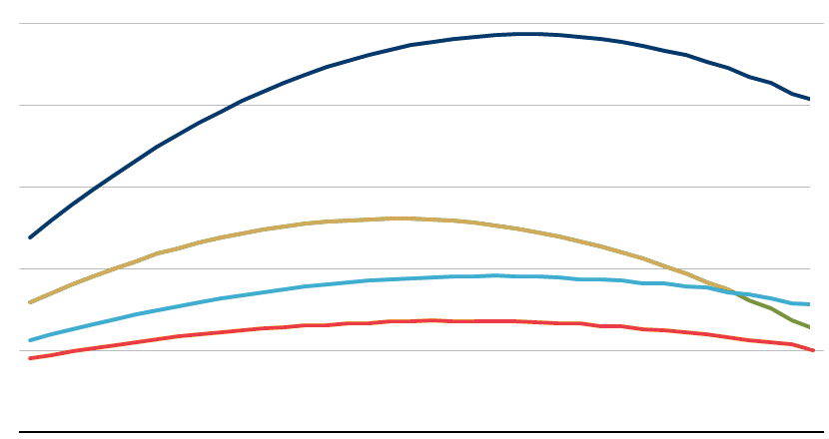
NO LONGER A GUARANTEE
BA & Above $49,000 for a Family of 4
BA & Below $49,000 for a Family of 4
HS & Above $49,000 for a Family of 4
Each year, 1.3 million low-income and first generation students go to college. Only 30% graduate and emerge with strong jobs.
HS & Below $49,000 for a Family of 4
EARNINGS
$100,000
66¢
Early Career: Low-income BA holders earn only 66¢ on the dollar compared to high-income peers
$80,000
$60,000
Mid Career: Low-income BA holders earn only 50¢ on the dollar compared to high-income peers
$40,000
50¢
$20,000
25 27 29 31 33 35 37 39 41 43 45 47 49 51 53 55 57 59 61
AGE
Source: Brookings
© 2023 Braven, Inc. All Rights Reserved
Notes:
Our work matters because only 30% of the 1.3 millions low-income and first gen college graduates will secure a strong job placement following graduation. Less than half graduate within 6 years and about half of those students emerge with quality career opportunities after graduation
We know that graduates from low-income backgrounds earn less than their higher income peers for basically their whole careers. They start out below and the gap grows from 66c---> 50c
If you look at the dark blue and gold line, you can see the difference.

Slide 21
SYSTEMIC INEQUALITIES
RACIAL & ETHNIC WEALTH GAPS
Among workers with a college degree, Black Americans make 78 cents and Latinx Americans make 85 cents for every dollar their white peers make.²
in national job outcomes and economic mobility
EARNINGS AMONG COLLEGE DEGREE HOLDERS
$1.00
Nationally, major inequities play out across lines of gender and race when it comes to economic mobility after college.
THE GENDER WEALTH GAP
$0.78
$0.85
$1.00
The gender pay gap is actually bigger among workers with a college degree than among those without. Among workers with a bachelor’s degree, women earn 74 cents for every dollar men make, which is less than the 78 cents earned by all workers without a college degree.¹
BLACK AMERICANS
LATINX/A/O AMERICANS
WHITE AMERICANS
While Asian Americans are less likely than Americans overall to live in poverty (10% vs. 13% as of 2019), there are large differences in poverty rates among Asian American subgroups. The Pew Research Center found that 12 of 19 Asian origin groups had poverty rates that were as high as or higher than the U.S. average.³
$1.00
$0.74
$0.78
$1.00
5%
30%
WOMEN WITH A COLLEGE DEGREE
ALL WORKERS WITHOUT A COLLEGE DEGREE
MEN WITH A COLLEGE DEGREE
6%
10%
13%
25%
INDIAN AMERICANS
ASIAN AMERICANS
ALL AMERICANS
MONGOLIAN AMERICANS
¹Cheeseman Day, J. (2019). “College Degree Widens Gender Earnings Gap.” The United States Census Bureau.
²Gould, E. (2017). “The State of American Wages 2019: A story of slow, uneven, and unequal wage growth over the last 40 years.” Economic Policy Institute
³Budiman, A. and Ruiz, N. (2021). “Key facts about Asian Americans, a diverse and growing population.” Pew Research Center.
21

Slide 22
THE COST OF RACISM
Black and Latinx households hold only 13% and 19% of the median wealth held by a White American family. Black Americans lost $90-$113 Billion in lifetime income since 2000 due to discrimination in accessing higher ed. Black and Latinx college grads make only 77¢ and 85¢ on the white dollar, respectively.
High School
$16.37
A difference of 18.4%
Black
$17.88
A difference of 10.8%
Latinx
$20.05
White
College
$27.81
A difference of 22.5%
$30.35
A difference of 15.5%
$35.90
Advanced Degree
$37.33
A difference of 17.6%
$40.80
A difference of 9.8%
$45.29
https://www.epi.org/publication/black-workers-covid/
https://www.federalreserve.gov/econres/notes/feds-notes/disparities-in-wealth-by-race-and-ethnicity-in-the-2019-survey-of-consumer-finances-20200928.htm
https://www.npr.org/sections/live-updates-protests-for-racial-justice/2020/09/23/916022472/cost-of-racism-u-s-economy-lost-16-trillion-because-of-discrimination-bank-says
© 2023 Braven, Inc. All Rights Reserved

Slide 23
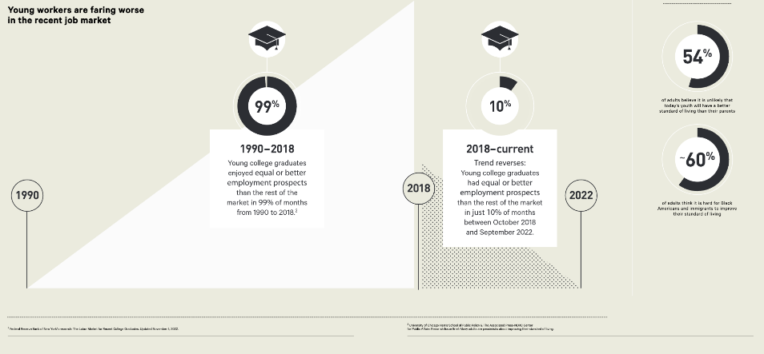
23
Notes:
Most of the information I am sharing today is pulled from our 2023 jobs report in Feb, which I will share following the session.
This is what we saw at the time of its release, in 1990 recent college graduates enjoyed equal or better employment opportunities than the rest of the market.…
however in 2018, that trend was reversed, and only 10% of recent college graduates. this trend has led to a decline in confidence for attaining the american dream

Slide 24
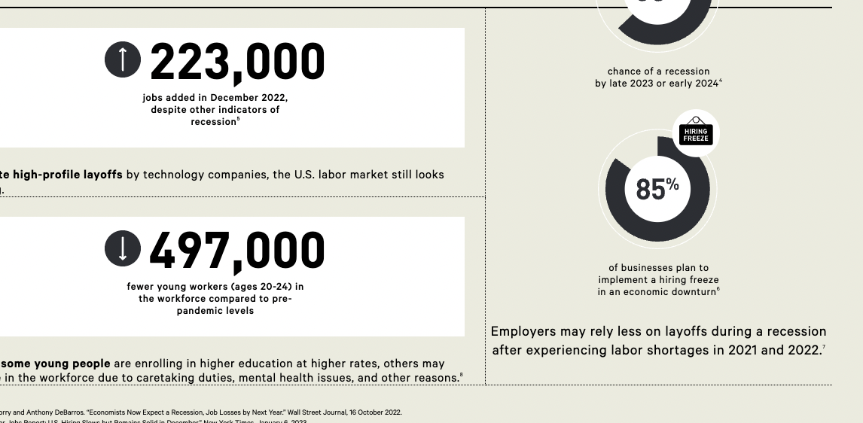
24
Notes:
In terms of what we are seeing in the job market currently,
as you heard, industries like the tech field have seen many layoffs in the last few months (as many as 150,000) and despite this the labor market still looks strong with about 223000 jobs added

Slide 25
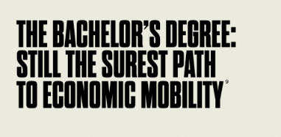
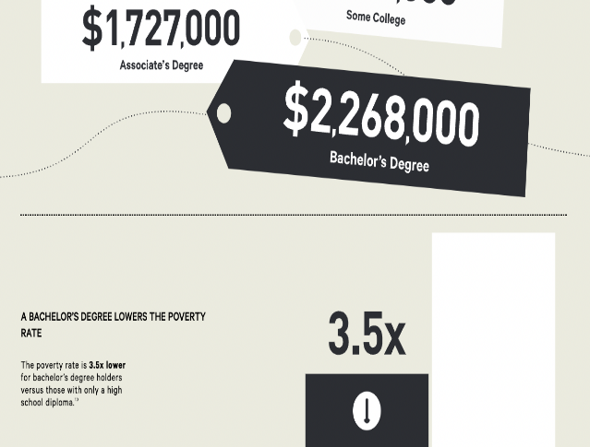
25
Notes:
And despite this we are hearing a lot of talk weather a degree is worth it and it still is, bachelors degree holder earns compared to a someone with a hs diploma
Once more, a bachelors degree lowers the poverty rate

Slide 26
THE RISE OF THE GEN Z PROFESSIONAL
The number of Gen Z workers in the United States is on pace to triple in size, growing to 51 million and making up 30% of the workforce by 2030. They are also coming of professional age at a time of massive changes in global ways of working.
We surveyed 600 rising seniors to best understand:
Job preferences
Desired benefits and perks
Preferred management styles
Importance of organizational culture
Concerns about the transition into the workforce
Notes:
*
Gen Z students are beginning to enter the workplace at a time when global ways of working are undergoing massive changes. To better understand Gen Z’s concerns as they launch their careers, Boston Consulting Group and America Needs You surveyed ~600 college students on their preferences for ways of working, job perks, management styles, and organizational cultures when evaluating potential employers. Their responses indicate a movement towards a hybrid future of work, with more emphasis on employers’ positive societal impact, individual support from managers—particularly for underrepresented students—and trainings on soft skills. These findings shed light on what employers, college career centers, and career development nonprofits can do to best support Gen Z as they transition from college to career.
Born after 1996, members of Gen Z are more racially and ethnically diverse than previous generations, and they are the most well-educated generation yet
Gen Z was expected to inherit a strong economy, but COVID-19 reshaped the social, political, and economic landscape, not to mention the daily routines that make up a workday. Many Gen Zers have spent the better part of their early careers or college experiences working or learning remotely
To understand future Gen Z workers preferences and attitudes towards work, we surveyed approximately 600 college students at public and private institutions across the U.S., mostly rising seniors. We sought to understand themes: about their job preferences, including most desirable benefits and perks, preferred management styles, and the most important aspects of organizational culture when they compare potential employers, and what concerns them the most about adapting to the workplace after graduation

Slide 27
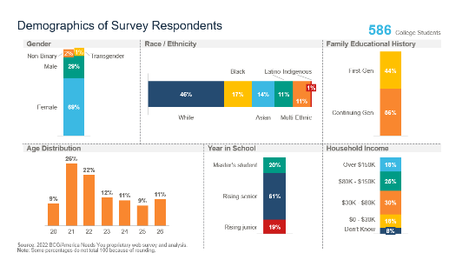
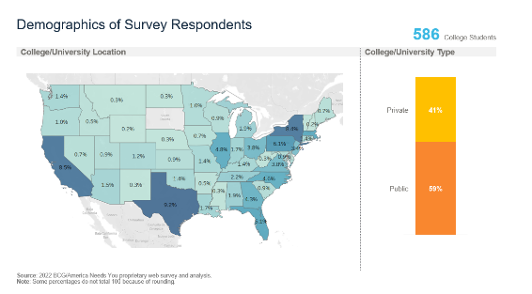
RESPONDENTS
Notes:
*

Slide 28
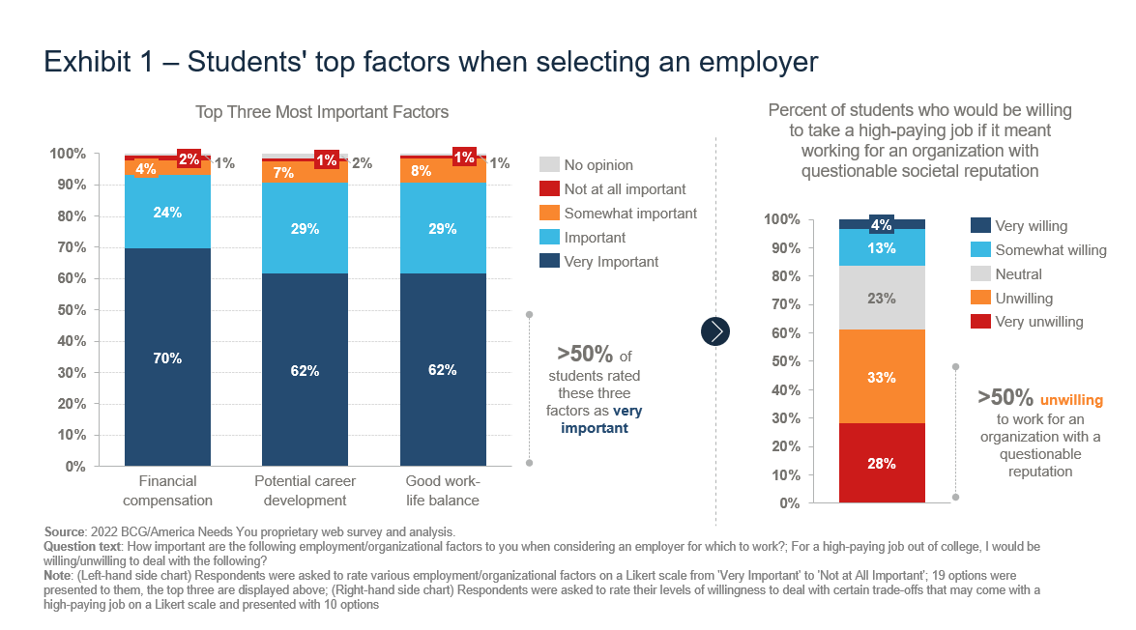
TOP FACTORS: SELECTING AN EMPLOYER
Notes:
*
While the data affirm Gen Z’s reputation for caring about positive social impact, they also show that many standard job benefits and perks are equally, if not more, important. When asked about selecting an employer, financial compensation (70%), work-life balance (62%), and career development (62%) were most often cited as very important factors for students. However, more than half (61%) of all Gen Zers are unwilling to take a highly compensated position if it’s with an organization that has a questionable societal reputation.

Slide 29
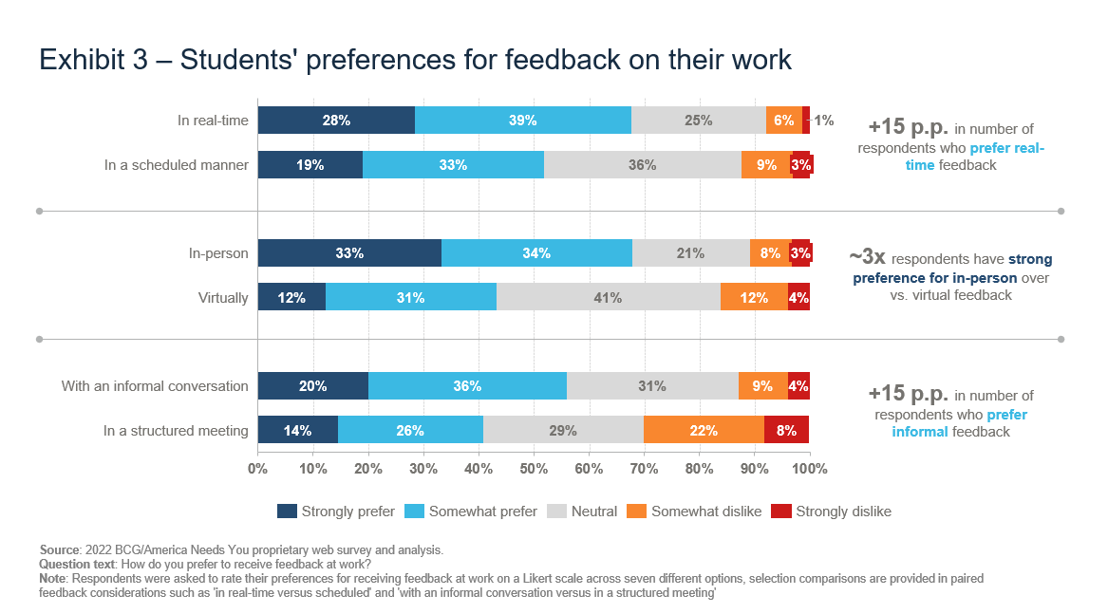
TOP FACTORS: PREFERENCES FOR FEEDBACK
Notes:
*
The preference for a hybrid working model perhaps stems from the recognition that virtual work has limitations, especially when it comes to relationship-building and learning. When asked about workplace interactions, Gen Z respondents valued face-to-face, real-time feedback with informal direction; almost three times as many respondents (67%) have a strong preference for in-person feedback from their manager as for feedback provided virtually.
They also prefer to work with managers who are effective communicators, honest and trustworthy, understanding and flexible, and caring about their employees and their careers. Gen Z least values a manager’s impressive credentials.

Slide 30
TOP FACTORS: MANAGERIAL PREFERENCES
Notes:
*
INTENSIVE CAREER DEVELOPMENT
24 Saturday workshops over the course of two years.
ANY follows a best-in-class curriculum focused on professional skills, career exploration, college completion, and personal growth.
ONE-ON-ONE MENTORSHIP
Each student (Fellow) is matched one-on-one with a mentor (Mentor Coach).
These pairs complete 220 hours of mentoring over two years.
Mentor Coaches provide industry insight and connections, as well as help Fellows set goals and stay on track academically and professionally.
ROBUST NETWORKS
Fellows interact with thousands of diverse professionals through workshops, Career Days (on-site employer visits), and internship/job opportunities at companies.
These opportunities allow Fellows to grow their professional, academic, and social networks.
HOLISTIC SUPPORT
ANY supports Fellows in over­coming personal and academic challenges, such as transfer support for Fellows enrolled in community college.

Slide 31
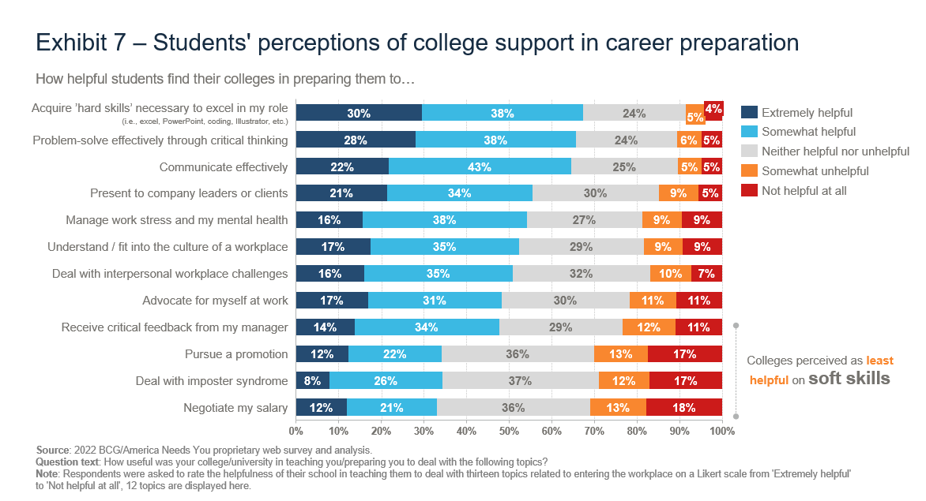
COLLEGE TO CAREER TRANSITION
Notes:
*
Gen Z generally believe their colleges and universities are preparing them for the workplace by teaching them hard skills as well as ways to effectively problem solve and communicate. However, survey respondents perceive a lack of support from their colleges when it comes to the soft skills required to progress as a professional, such as handling critical feedback from their manager, dealing with imposter syndrome, and managing salary conversations.

Slide 32
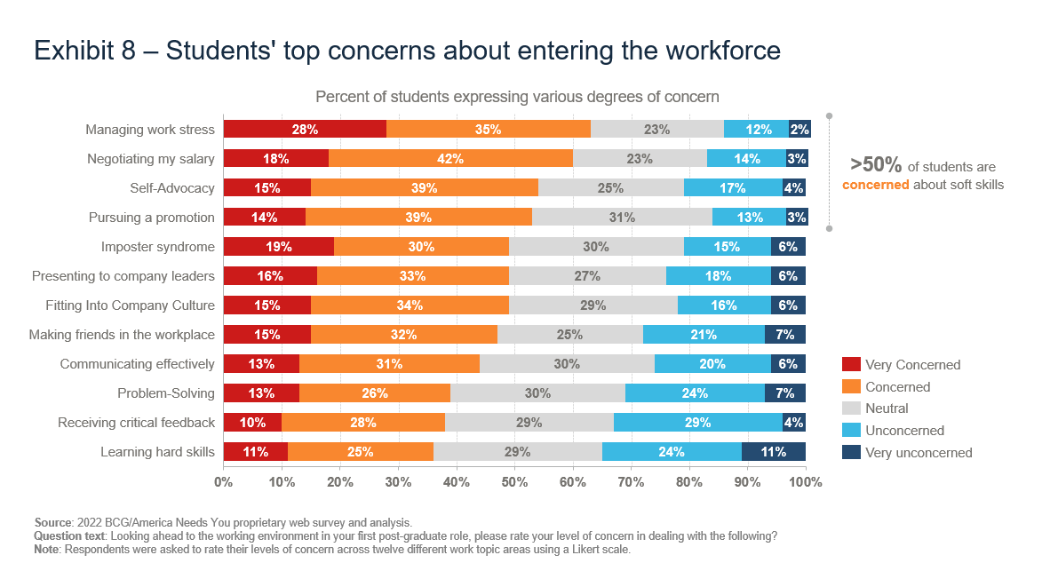
COLLEGE TO CAREER TRANSITION pg2
Notes:
*
Nearly two in three respondents (63%) are worried about managing stress at work. Other concerns about adapting to the workplace after graduation include negotiating a salary (60%), advocating for themselves (54%), pursuing a promotion (53%), and imposter syndrome (49%).
These data show gaps in current career preparation for most students. While many colleges provide academic and job placement support, few offer career development resources aimed at the transition to the workplace. Even fewer offer continued support after graduation to help recent graduates thrive once their career is launched.

Slide 33
RECOMMENDATIONS
Employers:
Lead with financial compensation
Offer a flexible working environment
Provide an enriching in-office experience
College Career Centers:
Go beyond job placements
Focus on soft skills
Nonprofits Organizations:
Continue filling the gaps
Provide focused support and provide mentorship
Notes:
*
Fellows receive:
INTENSIVE CAREER DEVELOPMENT
24 Saturday workshops over the course of two years.
ANY follows a best-in-class curriculum focused on professional skills, career exploration, college completion, and personal growth.
ONE-ON-ONE MENTORSHIP
Each student (Fellow) is matched one-on-one with a mentor (Mentor Coach).
These pairs complete 220 hours of mentoring over two years.
Mentor Coaches provide industry insight and connections, as well as help Fellows set goals and stay on track academically and professionally.
ROBUST NETWORKS
Fellows interact with thousands of diverse professionals through workshops, Career Days (on-site employer visits), and internship/job opportunities at companies.
These opportunities allow Fellows to grow their professional, academic, and social networks.
HOLISTIC SUPPORT
ANY supports Fellows in over­coming personal and academic challenges, such as transfer support for Fellows enrolled in community college.

Slide 34
RECOMMENDATIONS: CREATE OPPORTUNITIES FOR STUDENTS TO NETWORK
INFUSE HIGH-QUALITY CAREER PREP INTO ACADEMIC COURSEWORK
CREATE OPPORTUNITIES FOR STUDENTS TO NETWORK
PROVIDE STUDENTS WITH SAFE SPACES TO PRACTICE
Notes:
Colleges and universities also have a critical role to play, and they can start by infusing high-quality career preparation into academic coursework. This would make career development activities—such as guidance on how to apply their major to the work of work or help creating quality materials for a job search—accessible to all students, including those who work or have family commitments that limit what they can take on outside of class.
At Braven, we help Fellows develop lots of weak ties given the strength of these connections. You can create opportunities for students to meet professionals with hosting events like mock interviews, career treks, and encouraging mentorship with employer partners. At Braven, Fellows practice their interview skills with several real humans during Mock Interviews. They also pitch their final Capstone Challenge projects to members of the companies that partner with Braven to sponsor the challenges. We’ve seen students land internships with these companies afterwards.
It’s important to give students the opportunity to practice in low-stakes environments so that when they do get to real job interviews, they’ve had the practice, feedback, and opportunity to refine their skills. At Braven, we have cohorts of 5-8 students led by a volunteer coach who guides them throughout the course.

Slide 35
85% OF JOBS ARE FILLED THROUGH NETWORKING

Slide 36
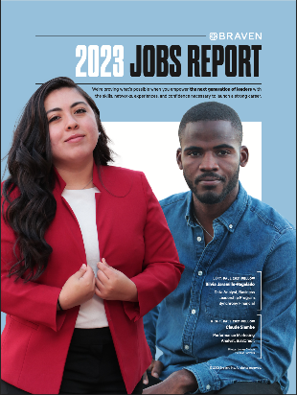
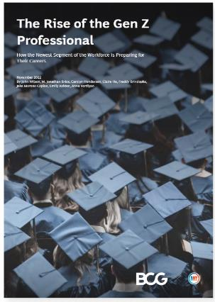
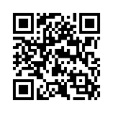
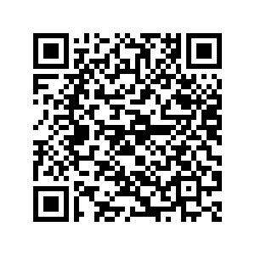
Reports

Slide 37
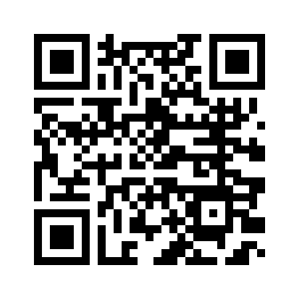
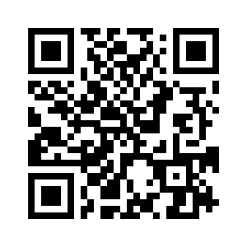
Thank you!
Follow us on LinkedIn
Jose Emily

